Slide 1
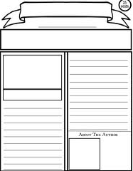
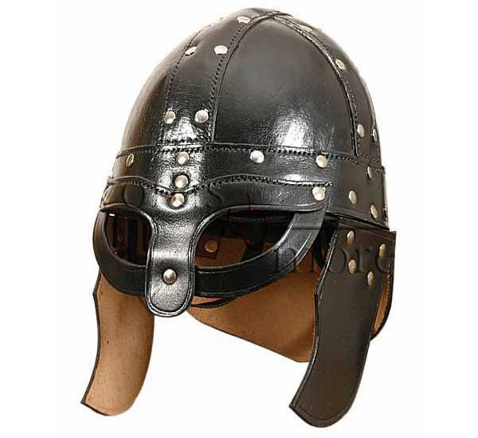
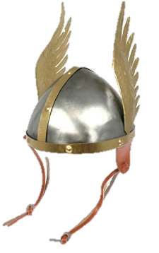
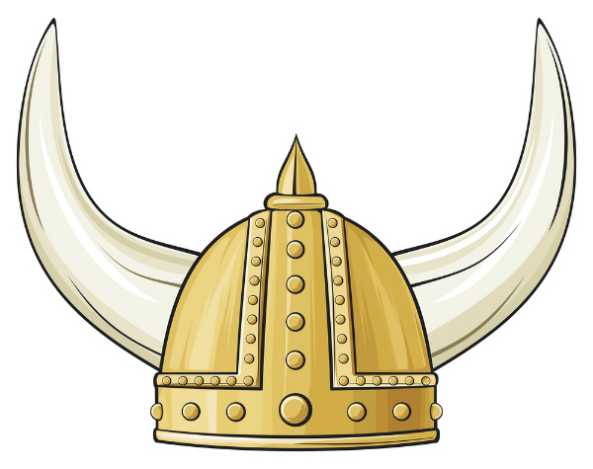
The Time Traveler
P. 1
By: Karrington Evans
Viking Civilization: 8000 B.C to A.D. 900)
Helmets without Horns?
Further reaserach was concluded; “Most Viking warriors were simple farmers and did not have a wealthy background.” It is therefore unlikely that they would be wearing helmets, as they were expensive to buy,”Reasearchers explained. Further more, there are not
that many helmets today that have survived and few burial mounts have contained helmets. Most likely the Vikings wore leather caps, possibly enforced with metal.
Breaking News:
Most people will probably visualize a Viking helmet with horns or even wings. This past week Researchers conducted research to sum up the confusion. They have concluded that a “real” Viking helmet is a bowl with a prominent nose guard, as shown in the photo of above. Therefore: Viking helmets had no horns. There is no evidence that Viking era helmets ever had horns.

Slide 2
"Hurstwic: Viking Helmets." Hurstwic: Viking Helmets. N.p., n.d. Web. 23 Sept. 2013.
http://www.hurstwic.org/history/articles/manufacturing/text/viking_helmets.htm
"Vikings History." Vikings History. N.p., n.d. Web. 23 Sept. 2013.
http://www.vikings-history.com/viking-helmets/
https://www.google.it/search?q=viking+helmets&um=1&ie=UTF-8&hl=en&tbm=isch&source=og&sa=N&tab=wi&ei=FHFAUrykEpDg7QawhIDABw

